Slide 1

Algebra 1
Unit 1, Lesson 10 Multiplying and Dividing Radical Expressions Volume 1, pg. 50

Slide 2


Benchmark
MA.912.NSO.1.4
Apply previous understanding of operations with rational numbers to add, subtract, multiply, and divide numerical radicals.
volume 1, pg. 50

Slide 3
Integrated Mathematical Thinking and Reasoning Standards
MA.K12.MTR.4.1 Engage in discussions that reflect on the mathematical thinking of self and others.
MA.K12.MTR.5.1 Use patterns and structure to help understand and connect mathematical concepts.
volume 1, pg. 50

Slide 4

Learning Target
I can multiply and divide two square roots or two cube roots.
volume 1, pg. 50

Slide 5

Warm-Up
volume 1, pg. 50

Slide 6
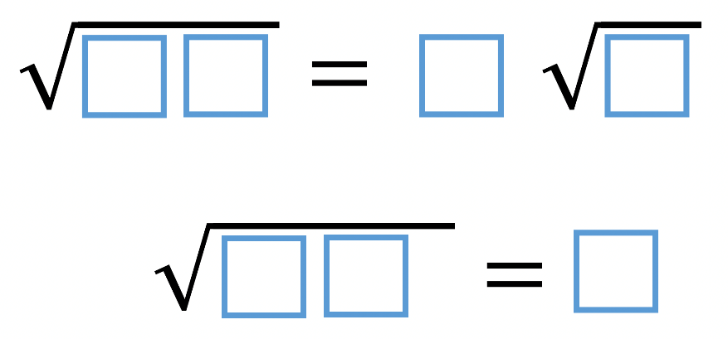
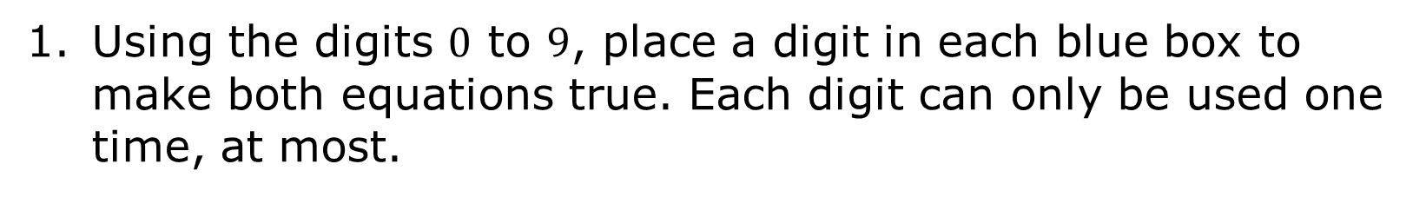
1.10.1 Warm-Up: True Equations
Using the digits $0$ to $9$, place a digit in each blue box to make both equations true. Each digit can only be used one time, at most.
volume 1, pg. 50
Notes:
Video Link: https://algebranation.wistia.com/medias/fi4fidi5y8

Slide 7

Guided Instruction
volume 1, pg. 51

Slide 8

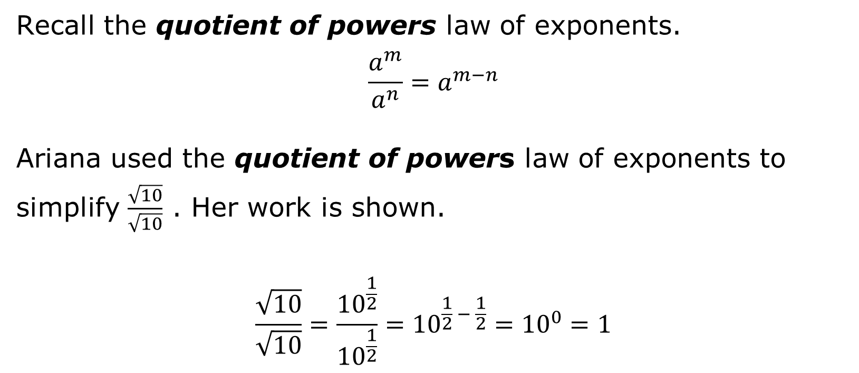
1.10.2 Guided Instruction: Multiplying and Dividing Radical Expressions
Recall the quotient of powers law of exponents.
$$\frac{a^{m}}{a^{n}}=a^{m−n}$$
Ariana used the quotient of powers law of exponents to simplify $\frac{\sqrt{10}}{\sqrt{10}}$ . Her work is shown.
$$\frac{\sqrt{10}}{\sqrt{10}}=\frac{{10}^{\frac{1}{2}}}{{10}^{\frac{1}{2}}}={10}^{\frac{1}{2} − \frac{1}{2}}={10}^{0}=1$$
volume 1, pg. 51

Slide 9
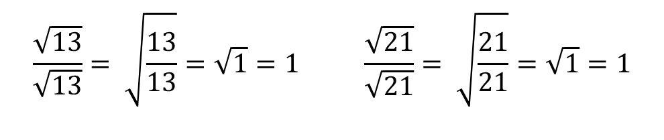
When dividing radicals with the same index, the quotient law of radicals is used to rewrite the expression. Each of the following equivalent expressions demonstrates the quotient law of radicals.
$$\frac{\sqrt{13}}{\sqrt{13}}= \sqrt{\frac{13}{13}}=\sqrt{1}=1$$ | $$\frac{\sqrt{21}}{\sqrt{21}}= \sqrt{\frac{21}{21}}=\sqrt{1}=1$$
volume 1, pg. 51

Slide 10
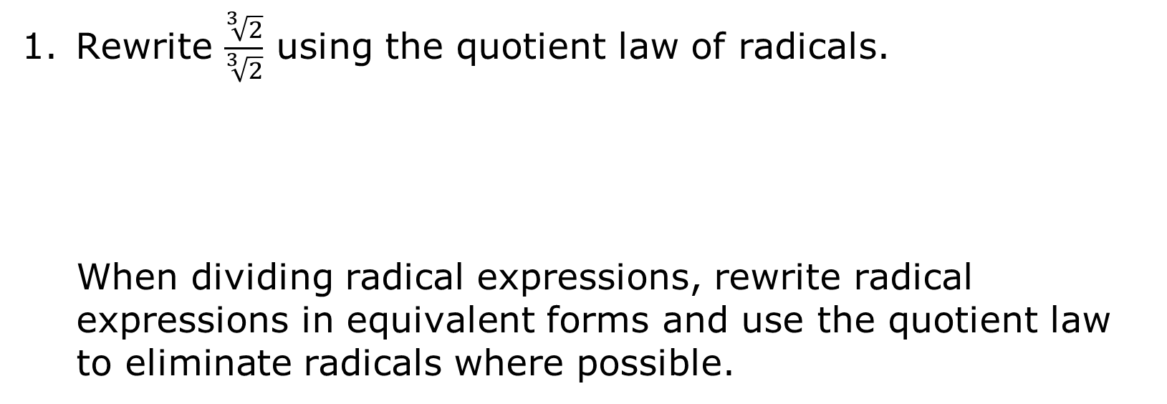
Rewrite $\frac{\sqrt[3]{2}}{\sqrt[3]{2}}$ using the quotient law of radicals.
When dividing radical expressions, rewrite radical expressions in equivalent forms and use the quotient law to eliminate radicals where possible.
volume 1, pg. 51

Slide 11
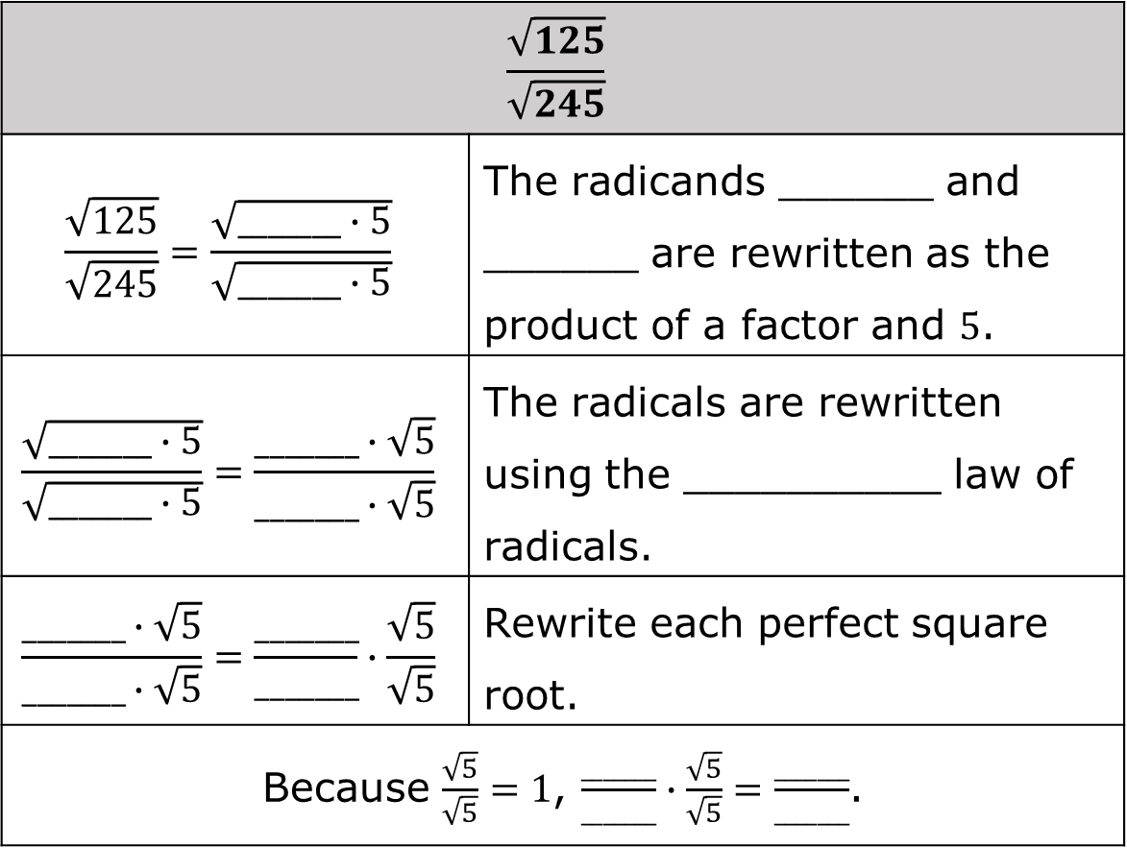
Write an equivalent expression for $\frac{\sqrt{125}}{\sqrt{245}}$.
$$\frac{\sqrt{125}}{\sqrt{245}}$$
$$\frac{\sqrt{125}}{\sqrt{245}}=\frac{\sqrt{_______∙5}}{\sqrt{_______∙5}}$$ | The radicands ______ and ______ are rewritten as the product of a factor and $5$.
$$\frac{\sqrt{_______∙5}}{\sqrt{_______∙5}}=\frac{_______∙\sqrt{5}}{_______∙\sqrt{5}}$$ | The radicals are rewritten using the __________ law of radicals.
$$\frac{_______∙\sqrt{5}}{_______∙\sqrt{5}}=\frac{_______}{_______}∙\frac{\sqrt{5}}{\sqrt{5}}$$ | Rewrite each perfect square root.
Because $\frac{\sqrt{5}}{\sqrt{5}}=1$, $\frac{_______}{_______}∙\frac{\sqrt{5}}{\sqrt{5}}=\frac{_______}{_______}$.
volume 1, pg. 51

Slide 12
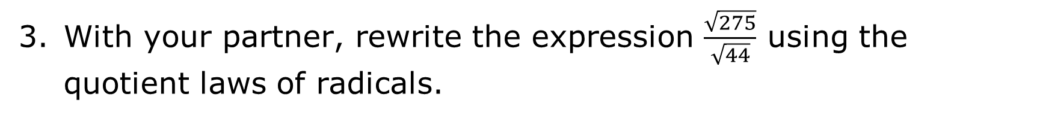
With your partner, rewrite the expression $\frac{\sqrt{275}}{\sqrt{44}}$ using the quotient laws of radicals.
volume 1, pg. 51

Slide 13

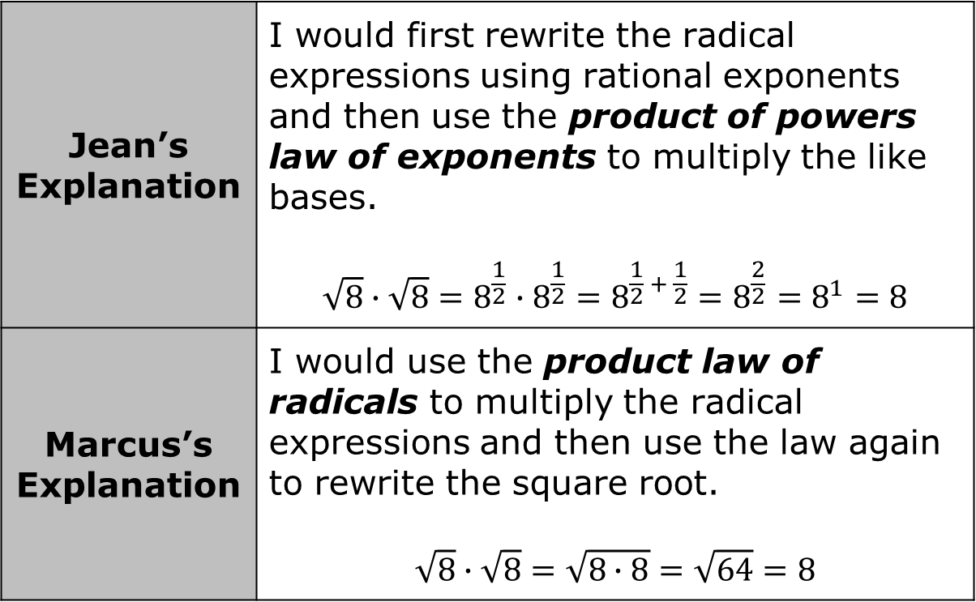
Jean and Marcus were asked to explain how they would multiply $\sqrt{8} ∙ \sqrt{8}$. Their explanations are shown.
Do you agree that both expressions have a value of $8$?
Jean’s Explanation | I would first rewrite the radical expressions using rational exponents and then use the product of powers law of exponents to multiply the like bases. $$\sqrt{8}∙\sqrt{8}=8^{\frac{1}{2}}∙8^{\frac{1}{2}}=8^{\frac{1}{2} + \frac{1}{2}}=8^{\frac{2}{2}}=8^{1}=8$$
Marcus’s Explanation | I would use the product law of radicals to multiply the radical expressions and then use the law again to rewrite the square root. $$\sqrt{8}∙\sqrt{8}=\sqrt{8∙8}=\sqrt{64}=8$$
volume 1, pg. 52

Slide 14

Explain which method you would use to multiply $\sqrt{12} ∙ \sqrt{12}$.
Multiply the following radical expressions.
$$\sqrt{6}∙\sqrt{18}$$
volume 1, pg. 52

Slide 15


A model of how to rationalize the expression $\frac{30}{\sqrt{2}}$ is shown.
$$\frac{30}{\sqrt{2}}∙\frac{\sqrt{2}}{\sqrt{2}}=\frac{30\sqrt{2}}{\sqrt{4}}=\frac{30\sqrt{2}}{2}=15\sqrt{2}$$
In cases where there is a fraction with a radical in the denominator, mathematicians use a technique called rationalizing the denominator to rewrite an expression.
volume 1, pg. 52

Slide 16

Activity
volume 1, pg. 53

Slide 17

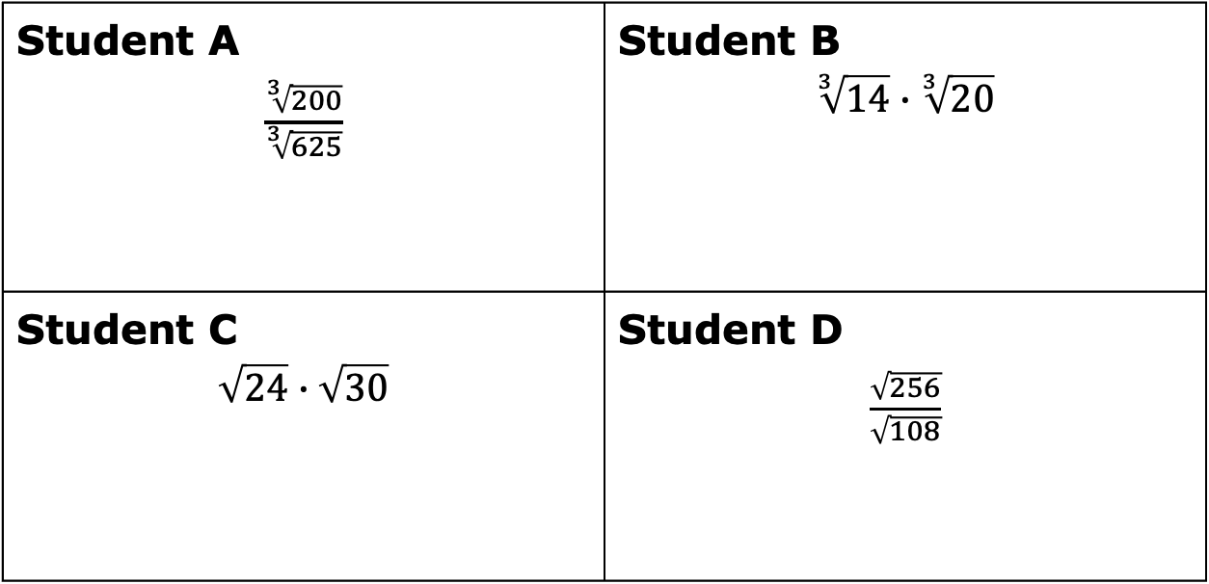
1.10.3 Activity: Pass Around
In groups of four, each student completes the first step of their problem. The students then pass their problem to the student on their right to complete the next step. For each new step, continue passing the problems to the student on the right.
Student A $\frac{\sqrt[3]{200}}{\sqrt[3]{625}}$ | Student B $$\sqrt[3]{14}∙\sqrt[3]{20}$$
Student C $$\sqrt{24}∙\sqrt{30}$$ | Student D $\frac{\sqrt{256}}{\sqrt{108}}$
volume 1, pg. 53

Slide 18

Your Turn
volume 1, pg. 53

Slide 19

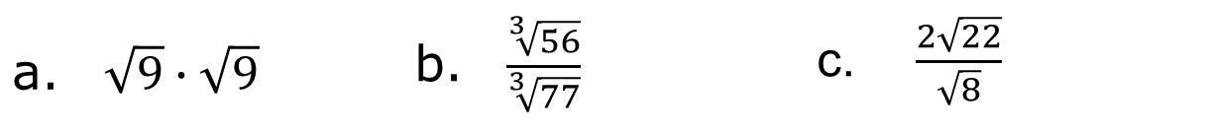
1.10.4 Your Turn!
Write an equivalent expression for each radical expression.
$\sqrt{9}∙\sqrt{9}$ | $\frac{\sqrt[3]{56}}{\sqrt[3]{77}}$ | $\frac{2\sqrt{22}}{\sqrt{8}}$
volume 1, pg. 53

Slide 20
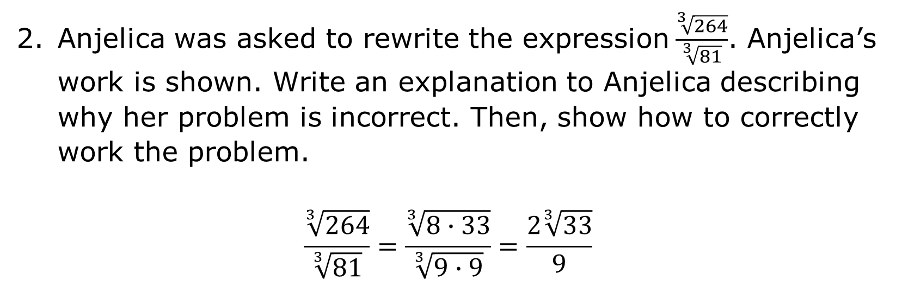
Anjelica was asked to rewrite the expression$\frac{\sqrt[3]{264}}{\sqrt[3]{81}}$. Anjelica’s work is shown. Write an explanation to Anjelica describing why her problem is incorrect. Then, show how to correctly work the problem.
$$\frac{\sqrt[3]{264}}{\sqrt[3]{81}}=\frac{\sqrt[3]{8∙33}}{\sqrt[3]{9∙9}}=\frac{2\sqrt[3]{33}}{9}$$
volume 1, pg. 53

Slide 21

Wrap-Up
volume 1, pg. 54

Slide 22
1.10.5 Wrap-Up: Reflection
Color in the arrow up to the statement that best describes your current understanding of the following.
I can multiply and divide two square roots or two cube roots.
 | I am so confident; I could explain this to someone else!
 | I can get to the right answer, but I do not understand well enough to explain it yet.
 | I understand some of this, but I do not understand all of it yet.
 | I tried hard and I listened, but I am finding this challenging. I will get help by …
 | I do not understand any of this yet. I will get help by ….
volume 1, pg. 54

